Slide 1
MATLAB – To – C connection

Slide 2
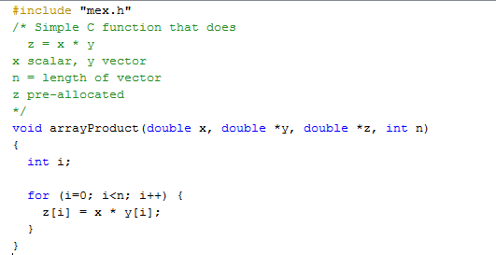

Slide 3
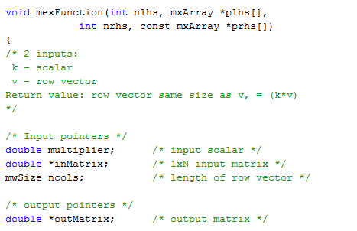

Slide 4
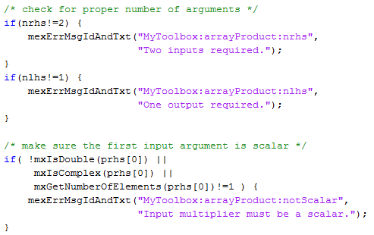

Slide 5
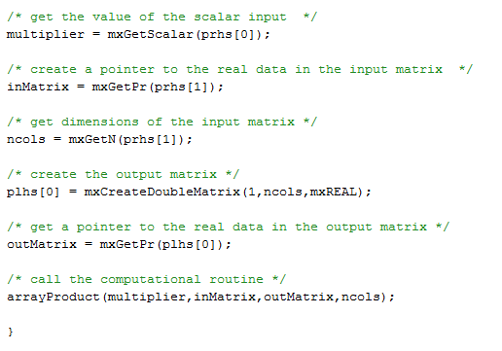

Slide 6
How to build and use the C code from inside MATLAB
All of that code is in ‘myfile.c’
in MATLAB, run
mex myfile.c
[may be asked to choose a compiler]
if no errors, can run the function
use same function name as the .c file.
z = myfile(x, y)

